Slide 1


Slide 2
Lecture By Arjun Pukale

Slide 3

Multivariable Linear Regression

Slide 4
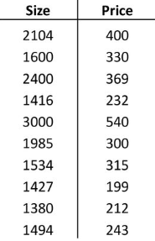
(X) (Y)

Slide 5
X has 1 feature
(X) (Y)

Slide 6

X has 1 feature
(X) (Y)
$$\hat{y_{i}}=wx_{i}+b$$

Slide 7
X has 1 feature
(X) (Y)
What if X has multiple Features ?
$$\hat{y_{i}}=wx_{i}+b$$

Slide 8
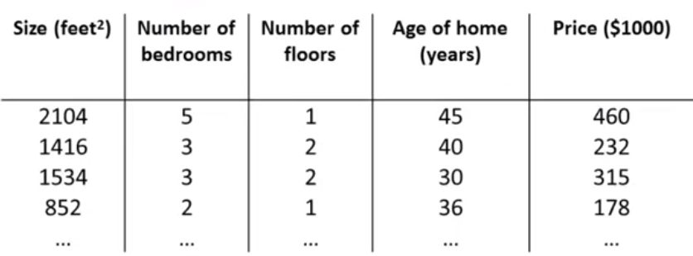

Slide 9
X
Y

Slide 10
X
Y
X has 4 features!!!

Slide 11
Some Notations
X
Y
m rows

Slide 12
Some Notations
X
Y
n features
m rows

Slide 13

Some Notations
X
Y
n features
m rows
$$X∈ ℝ^{m×n}$$

Slide 14

Some Notations
X
Y
n features
m rows
$x_{i}=i^{th}$ row of X

Slide 15

Some Notations
X
Y
n features
m rows
$x_{i}=i^{th}$ row of X
$x_{i}$ $∈ ℝ^{n}$

Slide 16

Some Notations
X
Y
n features
m rows
$x_{i}=i^{th}$ row of X
$$eg: x_{1}= \left[2104, 5, 1 ,45\right]∈ ℝ^{4}$$
$x_{i}$ $∈ ℝ^{n}$

Slide 17


Some Notations
X
Y
n features
m rows
$x_{i}=i^{th}$ row of X
$$eg: x_{1}= \left[2104, 5, 1 ,45\right]∈ ℝ^{4}$$
$x_{i}$ $∈ ℝ^{n}$
$$x_{ij}=j^{th} feature of i^{th}row$$
$eg:x_{24}$= 40

Slide 18

Some Notations
X
Y
n features
$\hat{y_{i}}=w_{1}x_{i1}+w_{2}x_{i2}+…+w_{n}x_{in}$+b
m rows
$x_{i}=i^{th}$ row of X
$$eg: x_{1}= \left[2104, 5, 1 ,45\right]∈ ℝ^{4}$$
$x_{i}$ $∈ ℝ^{n}$
$$x_{ij}=j^{th} feature of i^{th}row$$
$eg:x_{24}$= 40

Slide 19

Some Notations
X
Y
n features
$\hat{y_{i}}=w_{1}x_{i1}+w_{2}x_{i2}+…+w_{n}x_{in}$+b
$w$ = [$w_{1},w_{2},w_{3},w_{4}]∈ ℝ^{n}$
m rows
$x_{i}=i^{th}$ row of X
$$eg: x_{1}= \left[2104, 5, 1 ,45\right]∈ ℝ^{4}$$
$x_{i}$ $∈ ℝ^{n}$
$$x_{ij}=j^{th} feature of i^{th}row$$
$eg:x_{24}$= 40

Slide 20
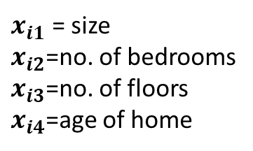
Some Notations
X
Y
n features
$\hat{y_{i}}=w_{1}x_{i1}+w_{2}x_{i2}+…+w_{n}x_{in}$+b
$w$ = [$w_{1},w_{2},w_{3},w_{4}]∈ ℝ^{n}$
$x_{i1}$ = size
$x_{i2}$=no. of bedrooms
$x_{i3}$=no. of floors
$x_{i4}$=age of home
m rows
$x_{i}=i^{th}$ row of X
$$eg: x_{1}= \left[2104, 5, 1 ,45\right]∈ ℝ^{4}$$
$x_{i}$ $∈ ℝ^{n}$
$$x_{ij}=j^{th} feature of i^{th}row$$
$eg:x_{24}$= 40

Slide 21
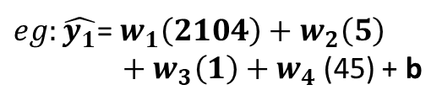
Some Notations
X
Y
n features
$\hat{y_{i}}=w_{1}x_{i1}+w_{2}x_{i2}+…+w_{n}x_{in}$+b
$w$ = [$w_{1},w_{2},w_{3},w_{4}]∈ ℝ^{n}$
$x_{i1}$ = size
$x_{i2}$=no. of bedrooms
$x_{i3}$=no. of floors
$x_{i4}$=age of home
m rows
$x_{i}=i^{th}$ row of X
$$eg: x_{1}= \left[2104, 5, 1 ,45\right]∈ ℝ^{4}$$
$eg:\hat{y_{1}}$= $w_{1}\left(2104\right)+w_{2}\left(5\right)$
${+ w}_{3}\left(1\right)+w_{4}$(45) + b
$x_{i}$ $∈ ℝ^{n}$
$$x_{ij}=j^{th} feature of i^{th}row$$
$eg:x_{24}$= 40

Slide 22
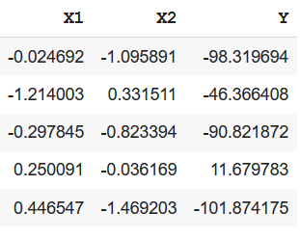
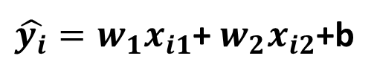
Eg:
$\hat{y_{i}}=w_{1}x_{i1}$+ $w_{2}x_{i2}$+b
Equation of a plane!!!
…………. …………… …………

Slide 23



